Slide 1
Full Stack Application Development
Web Protocols
HTTP
Connection Management
Akshaya Ganesan

Slide 2
HTTP Connection Management
HTTP 1.1 vs HTTP /2

Slide 3
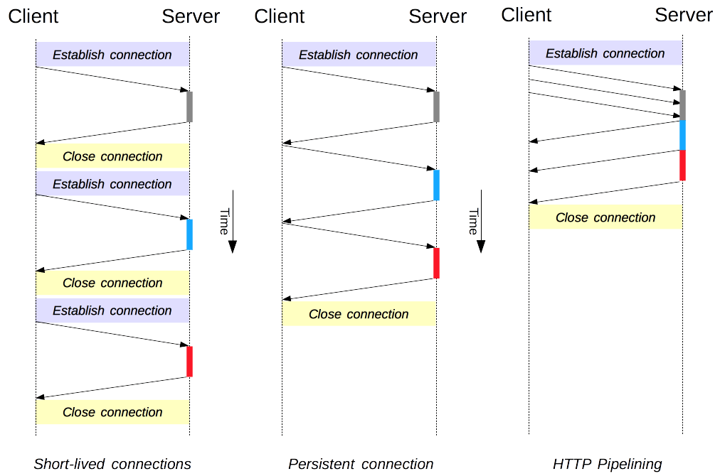

HTTP Connection 1.x
Reference: https://developer.mozilla.org/en-US/docs/Web/HTTP/Connection_management_in_HTTP_1.x

Slide 4
HTTP/1
HTTP/1.x clients need to use multiple connections to achieve concurrency and reduce latency;
-> Head of line Problem
HTTP/1.x does not compress request and response headers, causing unnecessary network traffic;
HTTP/1.x does not allow effective resource prioritization, resulting in poor use of the underlying TCP connection

Slide 5
HTTP/2
HTTP/2 enables a more efficient use of network resources and a reduced perception of latency by introducing header field compression and allowing multiple concurrent exchanges on the same connection.
Specifically, it allows interleaving of request and response messages on the same connection and uses an efficient coding for HTTP header fields.
It also allows prioritization of requests, letting more important requests complete more quickly, further improving performance.

Slide 6
HTTP/2
The resulting protocol is more friendly to the network, because fewer TCP connections can be used in comparison to HTTP/1.x.
This means less competition with other flows, and longer-lived connections, which in turn leads to better utilization of available network capacity.
Finally, HTTP/2 also enables more efficient processing of messages through use of binary message framing.

Slide 7
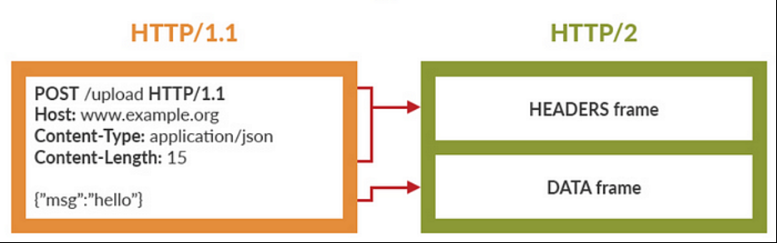
HTTP/2
Reference: https://web.dev/performance-http2/

Slide 8
HTTP/2
The introduction of the new binary framing mechanism changes how the data is exchanged between the client and server
Stream
A bidirectional flow of bytes within an established connection, which may carry one or more messages.
Message
A complete frame sequence that maps to a logical request or response message
Frame
The smallest unit of communication in HTTP/2, each containing a frame header, which at a minimum, identifies the stream to which the frame belongs.

Slide 9
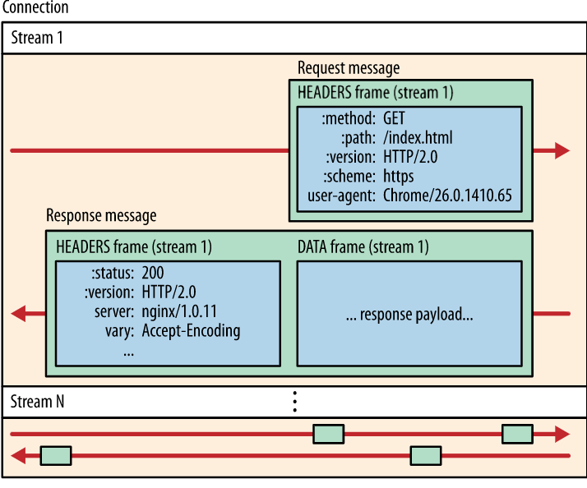

HTTP/2
Frames -> Messages -> Streams -> A single TCP connection
Reference: https://web.dev/performance-http2/

Slide 10
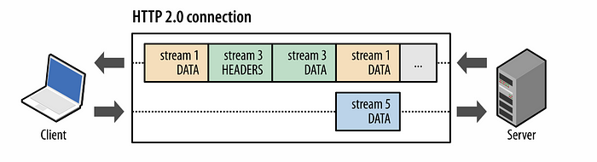
HTTP/2
Reference: https://web.dev/performance-http2/

Slide 11
Features and Benefits of HTTP/2
It’s a binary protocol
It used header compression HPACK to reduce the overhead size
It allows servers to “push” responses proactively into client caches instead of waiting for a new request for each resource
It reduces additional round trip times (RTT), making your website load faster without any optimization.
HTTP/2 supports response prioritization.
HTTP/2 also has problems, We now have HTTP/3 as well!

Slide 12
HTTP Connection Management

Slide 13
Thank You!

